Slide 1
Towards Accurate and Clinically Meaningful Summarization of Electronic Health Record Notes: A Guided Approach
Zhimeng Luo, Yuelyu Ji, Abhibha Gupta, Zhuochun Li, Adam Frisch, and Daqing He
University of Pittsburgh
BHI 2023
Notes:
Hi Everyone my name is Zhimeng Luo, I’m very happy to present our research project:

Slide 2
Objective: Automatically summarizing Electronic Health Record (EHR) by
guidance extraction
summary generation based on extracted guidance
fact-checking evaluation based on aspects in the template
Proposed summary template:
Patient is a Age year old Gender who presents with chief complaint. Insert important OPQRST information. Insert important diagnostics (labs, imaging). Insert treatments (medications, procedures). Patient was Disposition.
Summarization Example:
Source EHR
History of Present Illness: patient is a 74-year-old female presenting for evaluation of epigastric pain. … she states she has a
history of gerd and had similar symptoms in the past when her gallbladder acted up. … she was given aspirin and nitroglycerin
by ems, ... she states that actually walking around today made the epigastric discomfort better.
Medical Decision Making: patient presents for evaluation of epigastric pain. her ekg here shows no ischemic changes.
troponin was negative. … she feels comfortable going home to follow-up with her primary care doctor.
Output Summary
A 74-year-old female presents for evaluation of epigastric pain. She has a history of gerd and had similar symptoms in the past
when her gallbladder acted up. She was given aspirin and nitroglycerin by ems. She feels comfortable going home to follow-up
with her primary care doctor.
Notes:
Developed a standardized template serves as a guideline for the summarization process,
Each bracketed field in the template corresponds to a key aspect of the patient’s medical condition

Slide 3
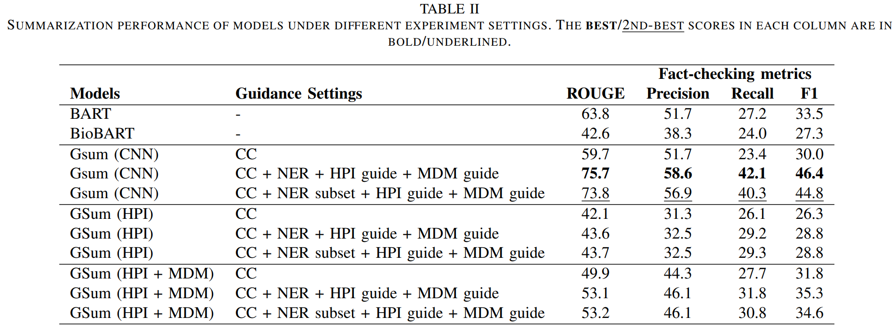
Framework
74 year old female
74 year old female
Epigastric pain
Epigastric pain
Named Entity
Recognition
Guidance
extraction
Input EHR
Pre-trained
Gsum (Bart)
N/A
Walking made discomfort better
Fact-checking
Sentence
Classification
N/A
Evaluation
Ekg no changes
Troponin was negative
Aspirin and nitroglycerin
Aspirin and nitroglycerin
Guidance
Going home
Going home
Output summary
Ground truth
Results
Clinical guidance works
ROUGE vs. fact-checking
Copy vs. paraphrasing
Welcome to our poster
for more details!
Notes:
Developed a standardized template serves as a guideline for the summarization process
Augmented guidance by automatically extracted critical information corresponding to aspects from the template
Designed a fact-checking metric based on the aspects outlined in the template by checking for the presence and accuracy of clinically meaningful phrases
For result:
The addition of clinical meaningful guidance enhances the performance
ROUGE score does not always align with the fact-checking metric (BART vs. GSum(HPI+MDM))
Gsum(CNN) tend to copy exact sentence from source, where as our pretrained model tend to paraphrase

